Slide 1
Summer’25

Slide 2
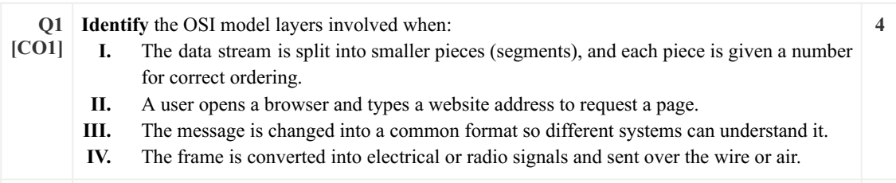
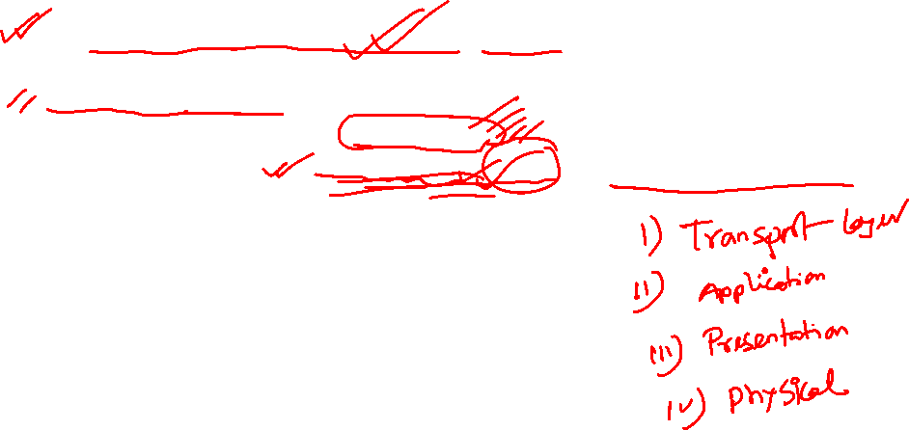
Transport layer
Application layer
Presentation Layer
Physical Layer

Slide 3
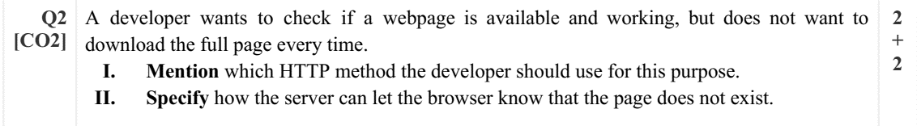
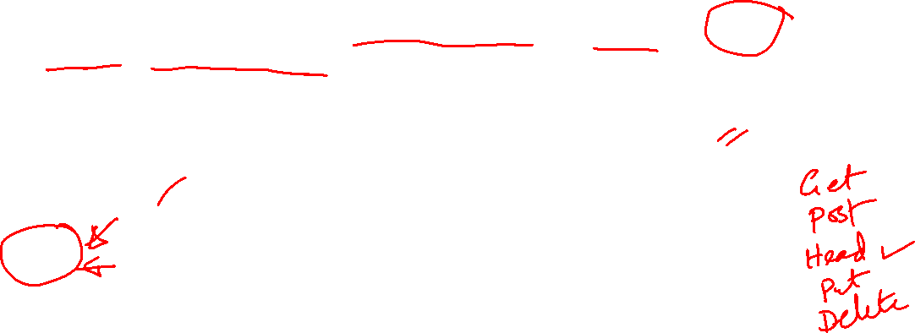
I) Head
404

Slide 4
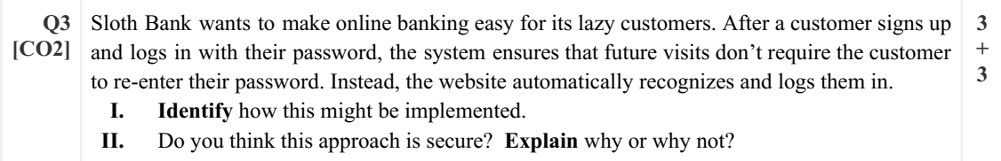
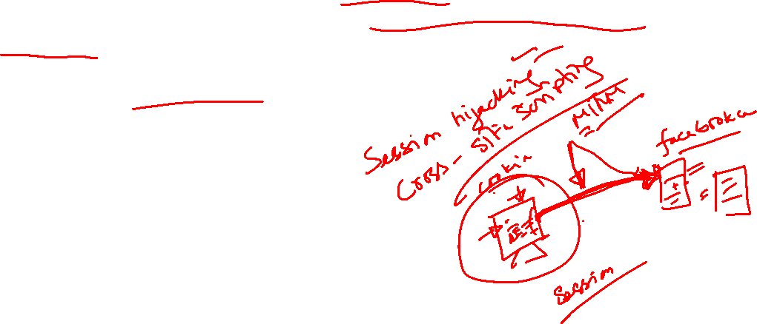
Cookies
No.
a) Device lost
b) Some attacks (such as cross-site scripting (XSS) can steal the cookie (especially session token) and hijack session.

Slide 5
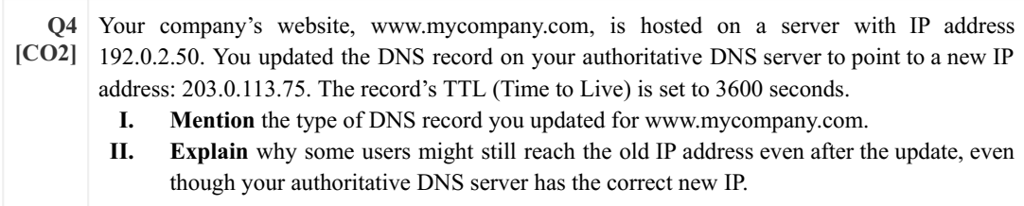
Type A (www.mycompany.com, 203.0.113.75, A)
They are still using the old IP address from their cache as TTL has not expired

Slide 6
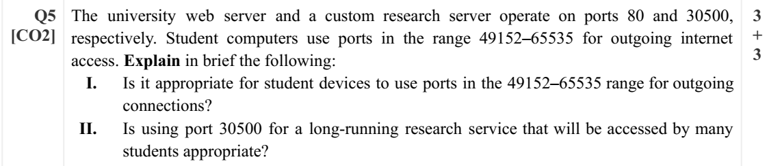
For outgoing connection, it is OK as the ports are private/dynamic
No. They have to register it for long time use

Slide 7
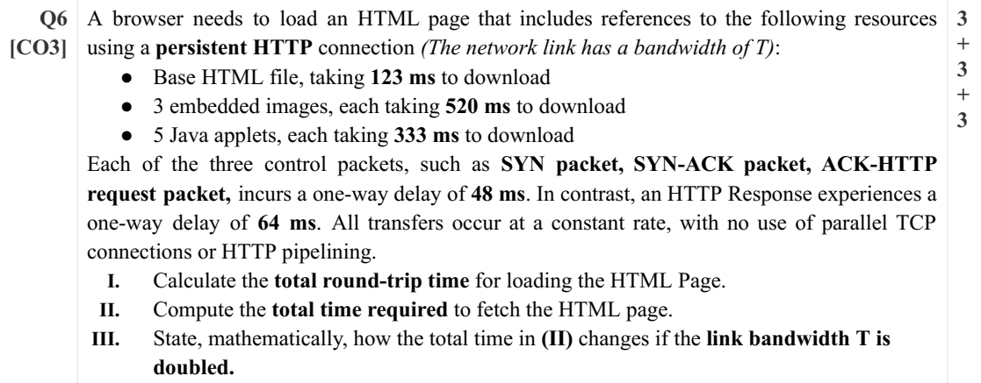
Total RTT: 1 TCP RTT+ N_obj*HTTP RTT
=(SYN+SYN-ACK)+N_obj*(ACK-HTTP Req+HTTP response)
=(48+48)+9*(48+64)=1104 ms
II) Total time=Total RTT+Total OTT=1104+(123+3*520+5*333) =4452 ms
III) Total time=Total RTT+Total OTT/2=1104+(123+3*520+5*333)/2=2778 ms

Slide 8
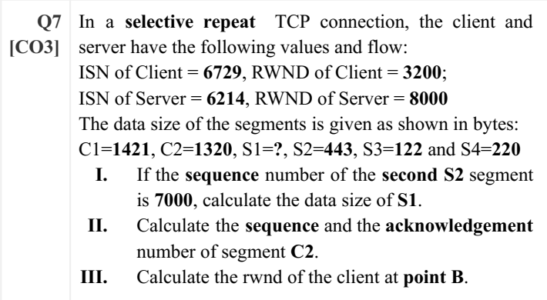

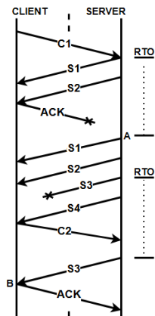
S1_seq=S_ISN+1=6214+1=6215
S1_seq+S1_size=S2_seq
6215+S1_size=7000, S1_size=785
C2_seq=C_ISN+1+C1=6729+1+1421=8151
C2_ACK=S_ISN+1+S1+S2+0 (S3 lost)=6214+1+785+443=7443
III) C_rewnd=C_initial_rwnd-data received
=3200-785-443-122-220=1630

